Slide 1
Chapter 1
Introduction to Electronics and Semiconductors
© Oxford University Press 2013. All rights reserved.

Slide 2
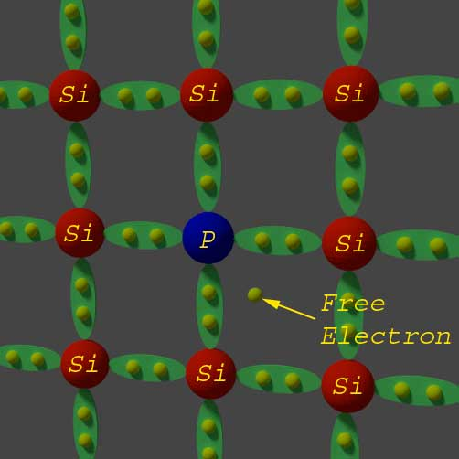
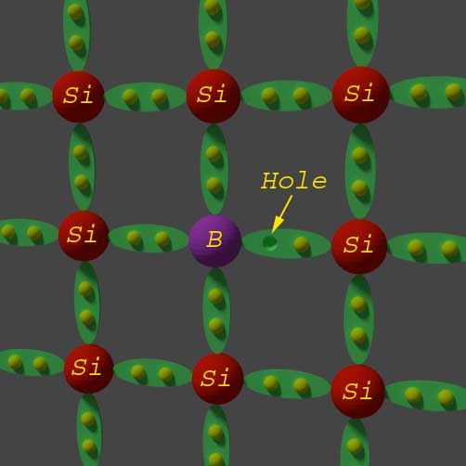
Donor and Acceptor Impurities in Semiconductor
N-TYPE SEMICONDUCTOR
P-TYPE SEMICONDUCTOR

Slide 3
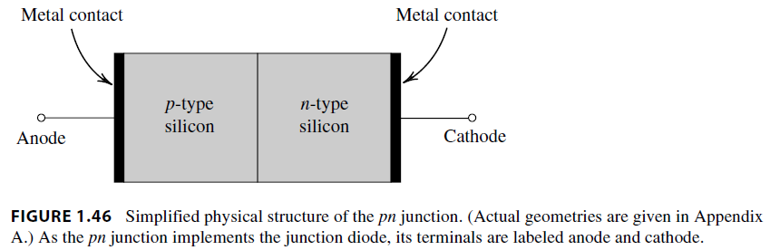
Junction DIODE
(Construction)
© Oxford University Press 2013. All rights reserved.

Slide 4
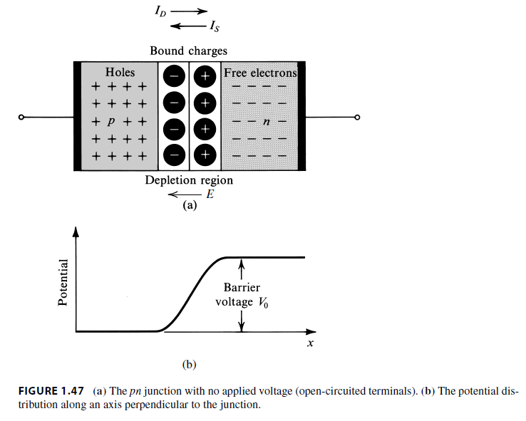
p-n Junction DIODE
(Open circuit)
P part has predominant holes and N part has predominant electrons as carriers.
Some holes diffuse to right side of junction into N part and electrons into left side into P part.
These bound charges create a barrier potential of voltage Vo.
© Oxford University Press 2013. All rights reserved.

Slide 5
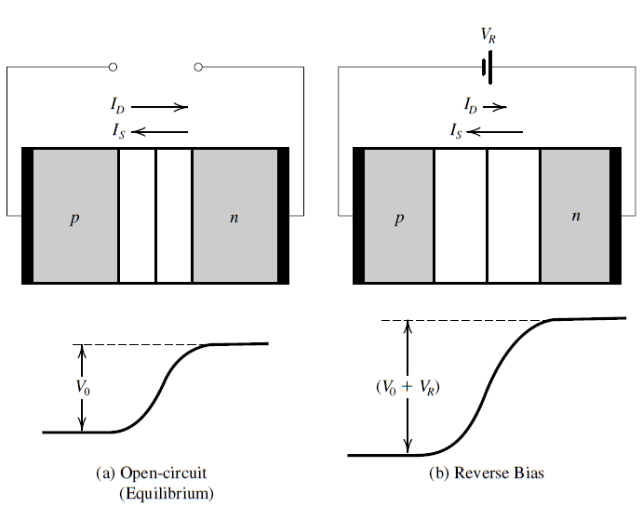
Junction Potential
(Open circuit & reverse bias)
When negative bias or reverse bias Vg is applied, the width of depleted region increases and barrier potential is raised.
contd
© Oxford University Press 2013. All rights reserved.

Slide 6
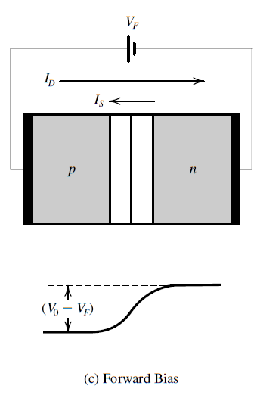
Junction Potential
(forward bias)
When positive bias or forward bias Vf is applied, the width of depleted region decreases and barrier potential is lowered.
Note that for the flow of current to be facilitated, a work function > than barrier potential must be applied.
© Oxford University Press 2013. All rights reserved.

Slide 7
Difference between zener diode and normal diode
The diode which have lesser doping undergo avalanche breakdown when high reverse voltage is applied. The lesser doping means the depletion width is large and so electric field within depletion region is not so high. Hence the electric field would not be able to pull out electrons from the outer shell of atoms and breakdown doesn’t occur in depletion region. But as the depletion region is large and hence when the minority charge carriers move through the depletion region, they get accelerated by the electric field and that even for larger time (as distance through which acceleration is provided is large). Hence minority charge carriers acquire high velocity and so high kinetic energy. When these charge carriers strike with atoms in the n-type and p-type regions, the high kinetic energy gets converted to thermal energy and hence due to this energy electrons from the outermost shell are pulled out and large current starts flowing. This type of breakdown is called avalanche breakdown.
But due to the high thermal energy, the temperature rises and diode gets burned. Due to this reason the simple diodes (where avalanche breakdown occurs) is not used in the applications and instead Zener diode is used in the application circuits of breakdown diodes such as regulating power supply.

Slide 8
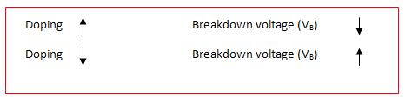
Difference between zener diode and normal diode
Zener breakdown Avalanche breakdown
The Zener breakdown occurs in HIGH 1. The avalanche breakdown occurs in LOW doping diodes. doping diodes.
The breakdown occurs within the 2. The breakdown occurs outside the depletion depletion region. region.
The breakdown voltage is lesser than 3. The breakdown voltage is more than zener that of avalanche breakdown. breakdown voltage.
As Zener breakdown voltage is less than that of avalanche breakdown voltage, hence Zener breakdown is said to occur before the avalanche breakdown.
Hence we can say if we increase the doping of a diode, the chances of zener
breakdown increases and hence breakdown voltage decreases

